Slide 1

Relational Database Design
Charles Severance
www.wa4e.com
http://www.wa4e.com/lectures/SQL-02-MySQL-Design-Handout.txt

Slide 2
Relational Database Design
http://en.wikipedia.org/wiki/Relational_model

Slide 3
Database Design
Database design is an art form of its own with particular skills and experience.
Our goal is to avoid the really bad mistakes and design clean and easily understood databases.
Others may performance tune things later.
Database design starts with a picture...

Slide 4
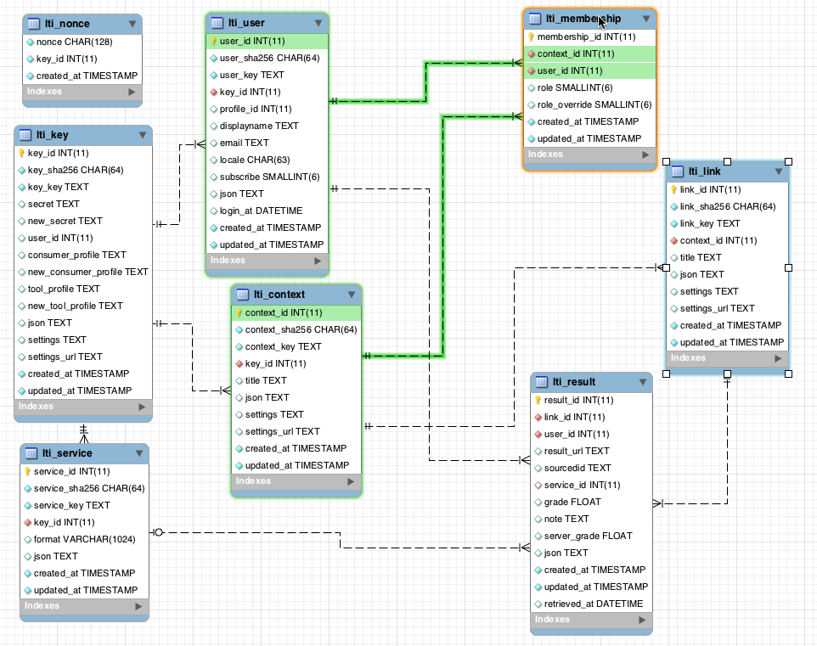
www.tsugi.org

Slide 5
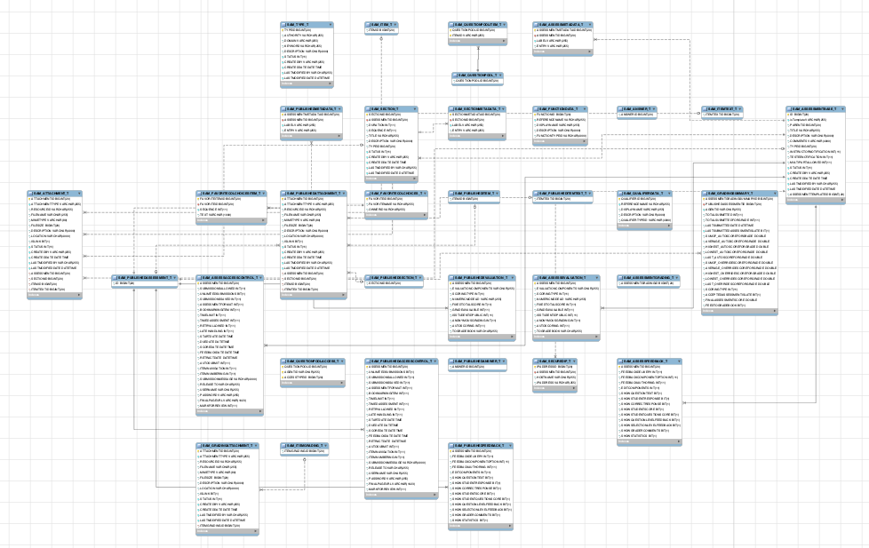
www.sakaiproject.org

Slide 6
Building a Data Model
Drawing a picture of the data objects for our application and then figuring out how to represent the objects and their relationships
Basic Rule: Don’t put the same string data in twice - use a relationship instead
When there is one thing in the “real world” there should only be one copy of that thing in the database

Slide 7
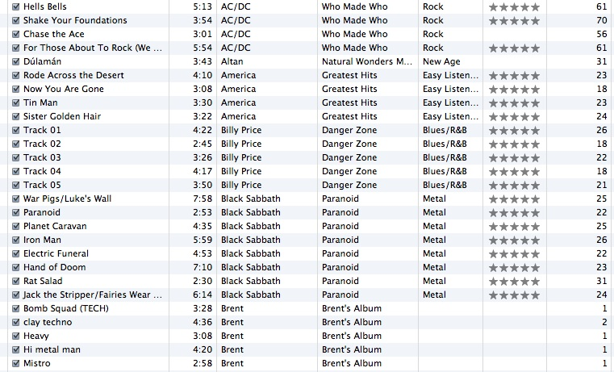
Track
Len
Artist
Album
Genre
Rating
Count

Slide 8
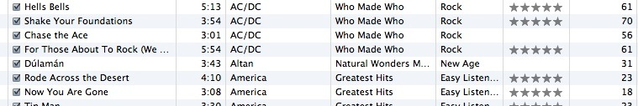
For each “piece of info”...
Is the column an object or an attribute of another object?
Once we define objects, we need to define the relationships between objects.
Len
Album
Genre
Artist
Rating
Track
Count

Slide 9
Track
Track
Artist
Rating
Album
belongs-to
Len
Artist
Count
Genre
Album
belongs-to
Rating
Len
belongs-to
Count
Genre

Slide 10
Track
Artist
Rating
belongs-to
Len
Count
Album
belongs-to
belongs-to
Genre

Slide 11
Normalization and Foreign Keys

Slide 12
We want to keep track of which band is the “creator” of each music track...
What album does this song “belong to”?
Which album is this song related to?

Slide 13
Database Normalization (3NF)
There is *tons* of database theory - way too much to understand without excessive predicate calculus
Do not replicate data. Instead, reference data. Point at data.
Use integers for keys and for references.
Add a special “key” column to each table, which you will make references to.
http://en.wikipedia.org/wiki/Database_normalization

Slide 14
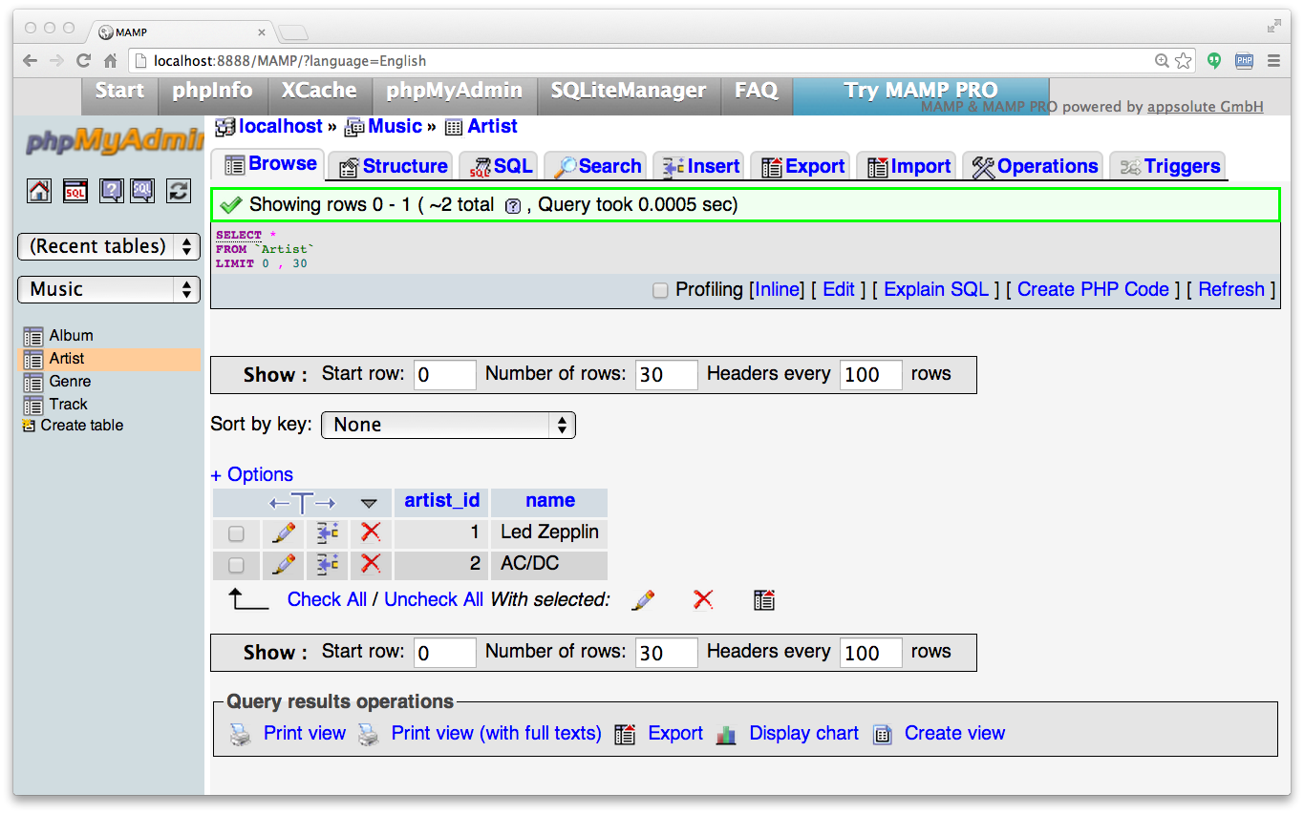
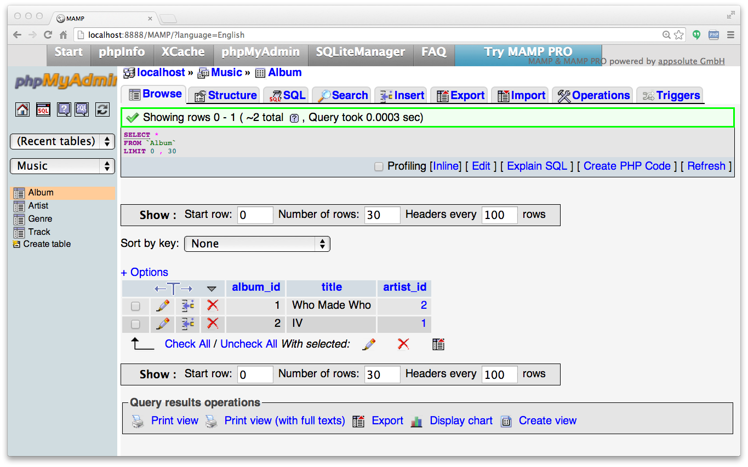
Integer Reference Pattern
We use integer columns in one table to reference (or look up) rows in another table.
Artist
Album

Slide 15
Key Terminology
Finding our way around....

Slide 16
Three Kinds of Keys
Primary key - generally an integer auto-increment field
Logical key - what the outside world uses for lookup
Foreign key - generally an integer key pointing to a row in another table
Album
album_id
title
artist_id
...

Slide 17
Primary Key Rules
Best practices:
Never use your logical key as the primary key.
Logical keys can and do change, albeit slowly.
Relationships that are based on matching string fields are less efficient than integers.
User
user_id
email
password
name
created_at
modified_at
login_at

Slide 18
Foreign Keys
A foreign key is when a table has a column containing a key that points to the primary key of another table.
When all primary keys are integers, then all foreign keys are integers. This is good - very good.
Album
album_ id
title
artist_id
...
Artist
artist_id
name
...

Slide 19
Building a Physical Data Schema

Slide 20
Track
Artist
belongs-to
Rating
Len
Album
Count
belongs-to
belongs-to
Genre

Slide 21
belongs-to
Track
Album
Title
Rating
Len
Track
Count
track_id
title
Album
rating
Table
Primary key
Logical key
Foreign key
album_id
len
title
count
album_id

Slide 22
Artist
Track
artist_id
track_id
Album
name
title
album_id
rating
title
len
artist_id
Table
Primary key
Logical key
Foreign key
count
album_id
Genre
genre_id
genre_id
Naming the Foreign key artist_id is a convention
name

Slide 23
Creating our Music Database
CREATE DATABASE Music
DEFAULT CHARACTER SET utf8;
USE Music;

Slide 24
CREATE TABLE Artist (
artist_id INTEGER NOT NULL AUTO_INCREMENT PRIMARY KEY,
name VARCHAR(255)
) ENGINE = InnoDB;
CREATE TABLE Album (
album_id INTEGER NOT NULL AUTO_INCREMENT PRIMARY KEY,
title VARCHAR(255),
artist_id INTEGER,
INDEX USING BTREE (title),
CONSTRAINT FOREIGN KEY (artist_id)
REFERENCES Artist (artist_id)
ON DELETE CASCADE ON UPDATE CASCADE
) ENGINE = InnoDB;

Slide 25
CREATE TABLE Genre (
genre_id INTEGER NOT NULL AUTO_INCREMENT PRIMARY KEY,
name VARCHAR(255),
INDEX USING BTREE (name)
) ENGINE = InnoDB;
CREATE TABLE Track (
track_id INTEGER NOT NULL AUTO_INCREMENT PRIMARY KEY,
title VARCHAR(255),
len INTEGER,
rating INTEGER,
count INTEGER,
album_id INTEGER,
genre_id INTEGER,
INDEX USING BTREE (title),
CONSTRAINT FOREIGN KEY (album_id) REFERENCES Album (album_id)
ON DELETE CASCADE ON UPDATE CASCADE,
CONSTRAINT FOREIGN KEY (genre_id) REFERENCES Genre (genre_id)
ON DELETE CASCADE ON UPDATE CASCADE
) ENGINE = InnoDB;

Slide 26
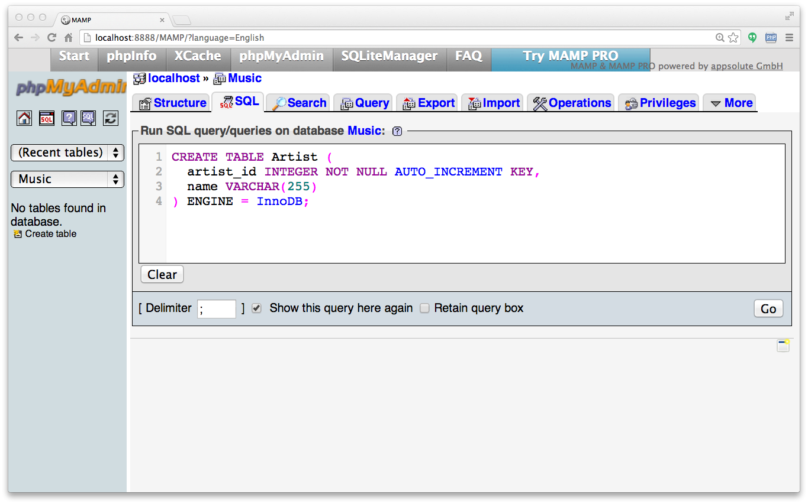

Slide 27
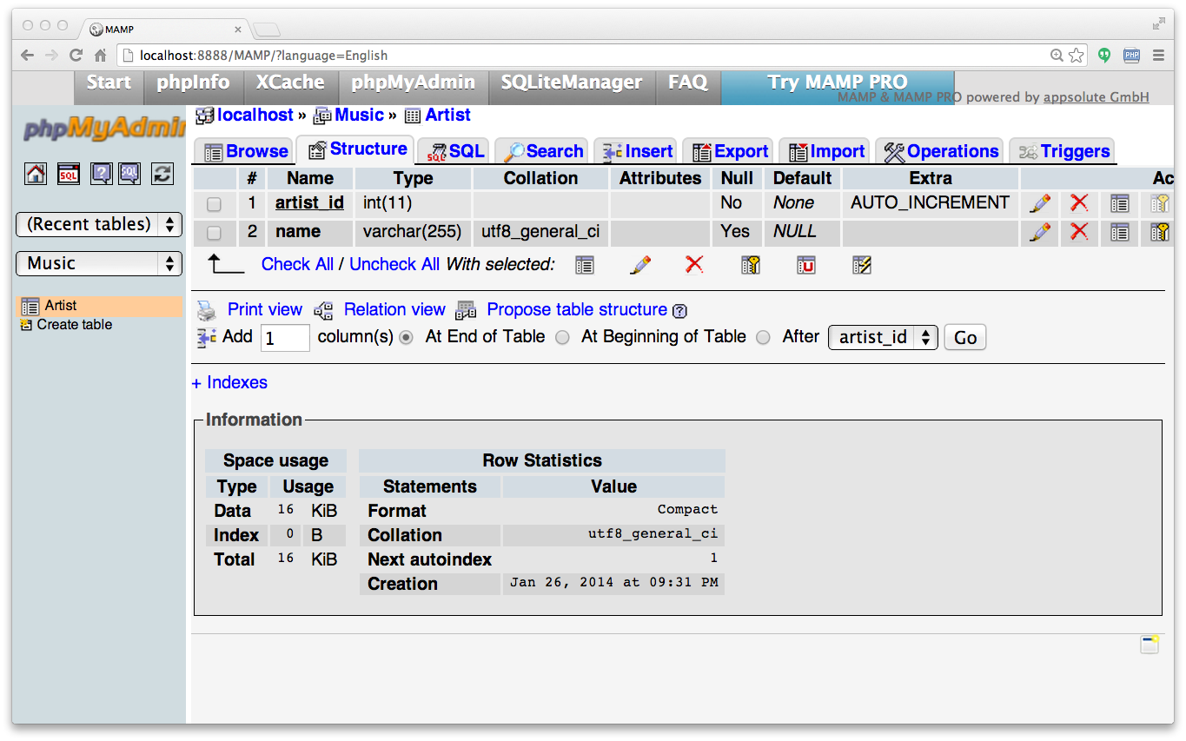

Slide 28
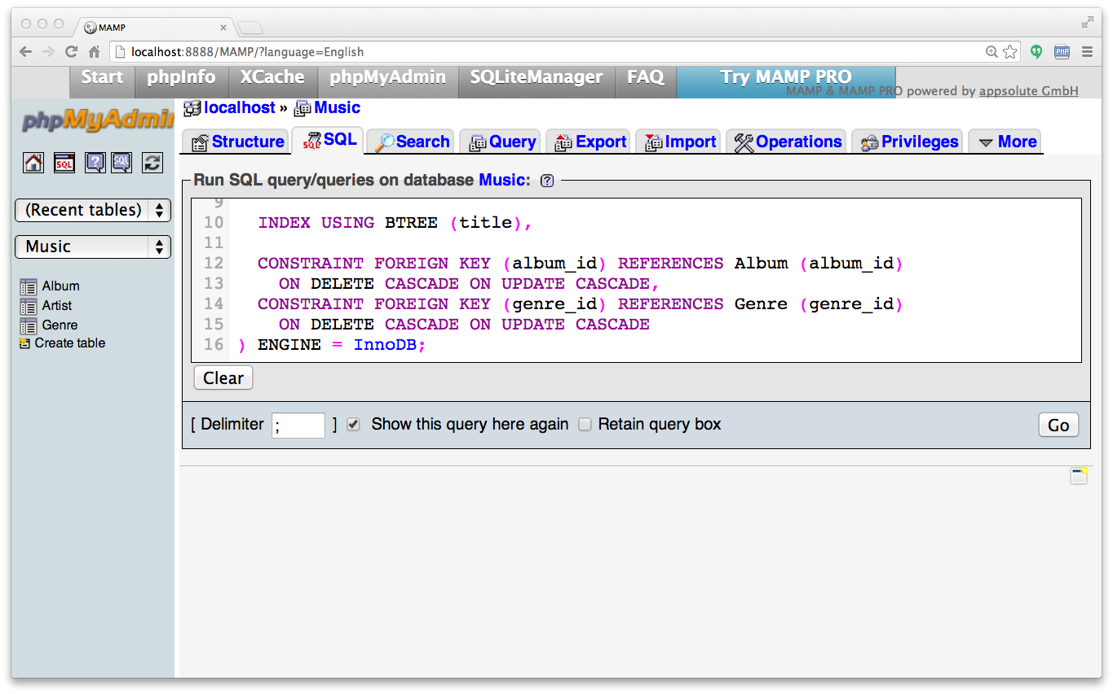

Slide 29
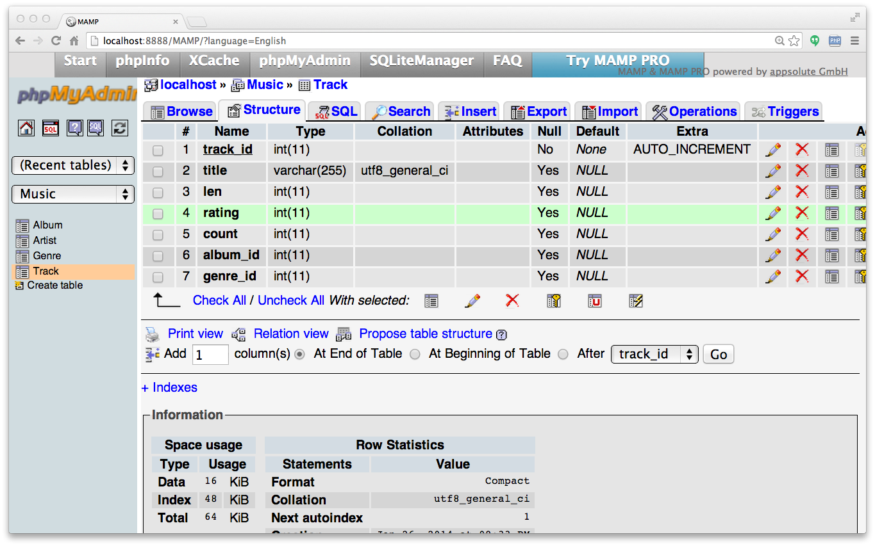

Slide 30
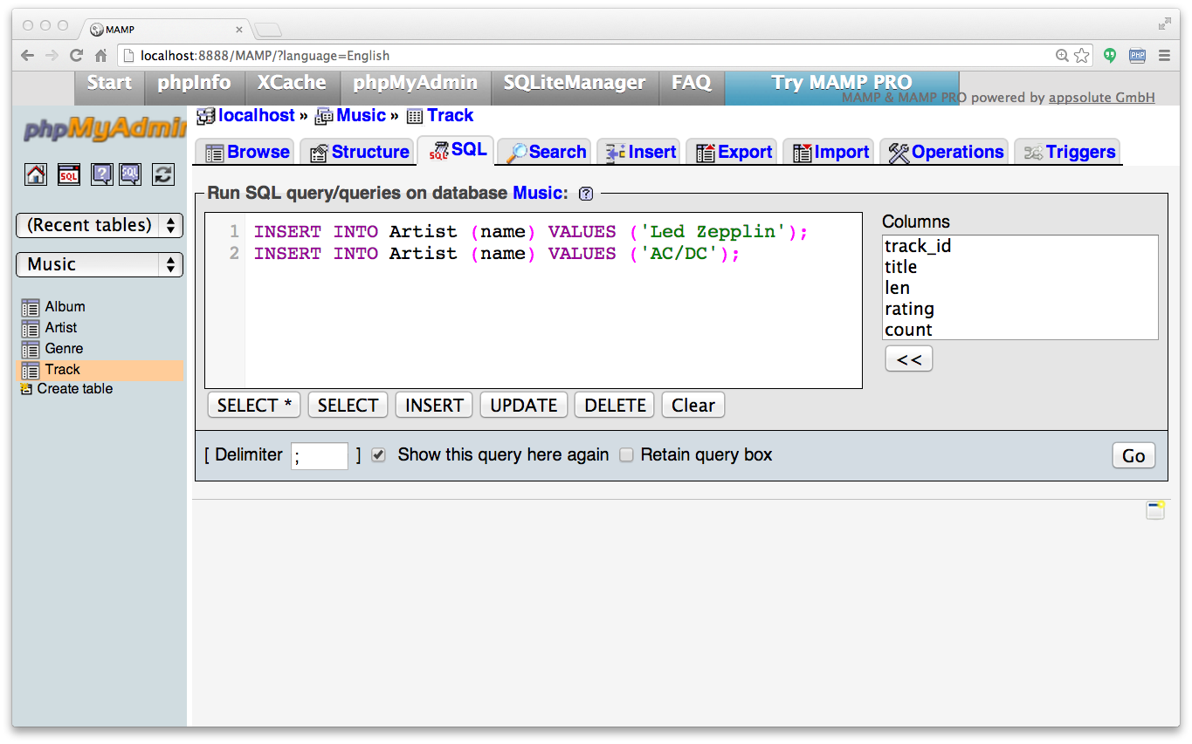
INSERT INTO Artist (name) VALUES ('Led Zepplin');
INSERT INTO Artist (name) VALUES ('AC/DC');

Slide 31
INSERT INTO Artist (name) VALUES ('Led Zepplin');
INSERT INTO Artist (name) VALUES ('AC/DC');

Slide 32
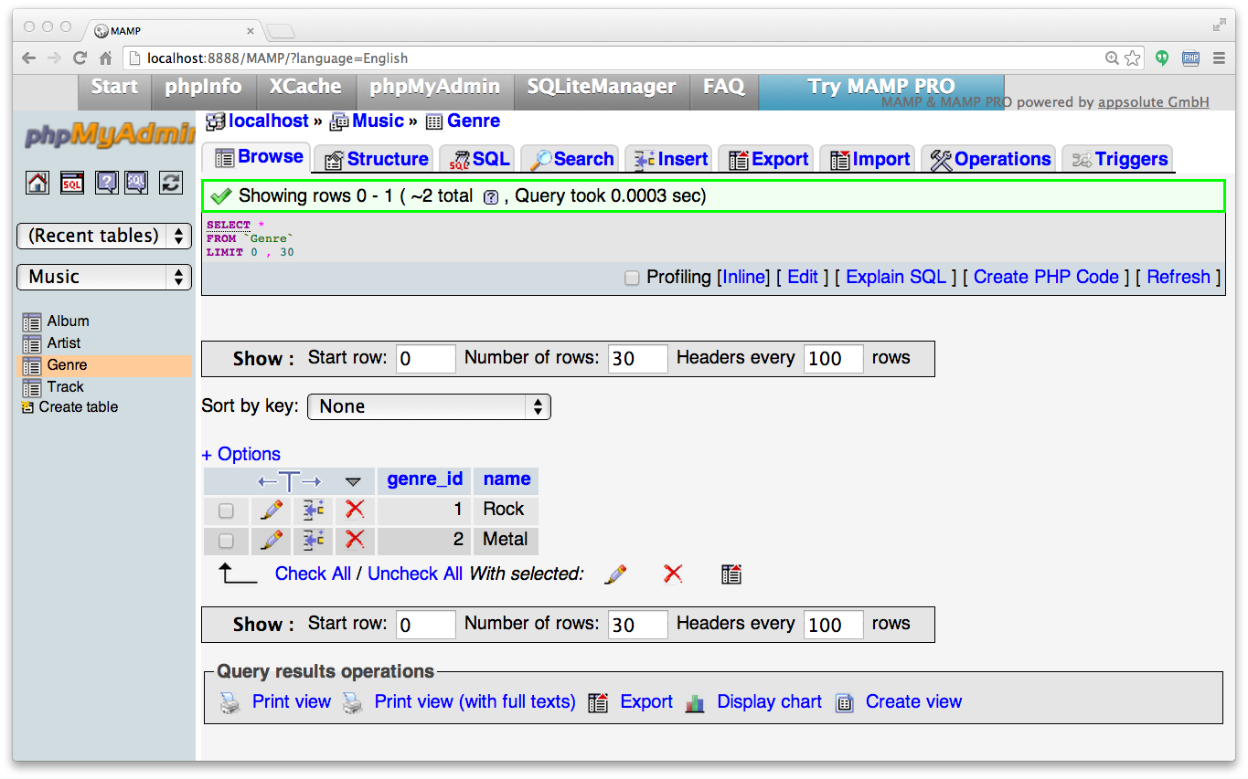
INSERT INTO Genre (name) VALUES ('Rock');
INSERT INTO Genre (name) VALUES ('Metal');

Slide 33
INSERT INTO Album (title, artist_id) VALUES ('Who Made Who', 2);
INSERT INTO Album (title, artist_id) VALUES ('IV', 1);

Slide 34
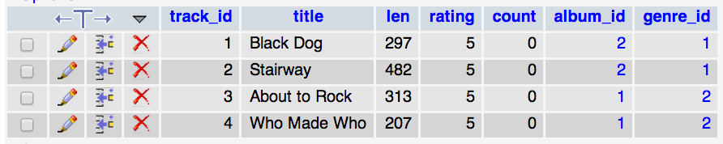
INSERT INTO Track
(title, rating, len, count, album_id, genre_id)
VALUES ('Black Dog', 5, 297, 0, 2, 1);
INSERT INTO Track
(title, rating, len, count, album_id, genre_id)
VALUES ('Stairway', 5, 482, 0, 2, 1);
INSERT INTO Track
(title, rating, len, count, album_id, genre_id)
VALUES ('About to Rock', 5, 313, 0, 1, 2);
INSERT INTO Track
(title, rating, len, count, album_id, genre_id)
VALUES ('Who Made Who', 5, 207, 0, 1, 2);

Slide 35
We Have Relationships!
Track
Album
Genre
Artist

Slide 36
Using Join Across Tables
http://en.wikipedia.org/wiki/Join_(SQL)

Slide 37
Relational Power
By removing the replicated data and replacing it with references to a single copy of each bit of data, we build a “web” of information that the relational database can read through very quickly - even for very large amounts of data.
Often when you want some data it comes from a number of tables linked by these foreign keys.

Slide 38
The JOIN Operation
The JOIN operation links across several tables as part of a SELECT operation.
You must tell the JOIN how to use the keys that make the connection between the tables using an ON clause.

Slide 39
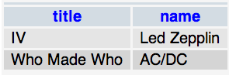
The tables that hold the data
SELECT Album.title, Artist.name FROM Album JOIN Artist ON
Album.artist_id = Artist.artist_id
What we want to see
How the tables are linked

Slide 40
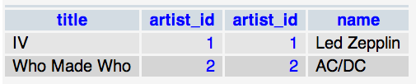
Album.title Album.artist_id Artist.artist_id Artist.name
SELECT Album.title, Album.artist_id, Artist.artist_id,Artist.name
FROM Album JOIN Artist ON Album.artist_id = Artist.artist_id

Slide 41
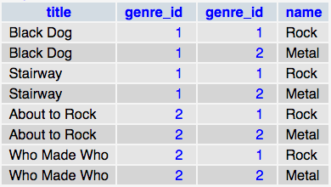
SELECT Track.title,
Track.genre_id,
Genre.genre_id,
Genre.name
FROM Track JOIN Genre
Joining two tables without an ON clause gives all possible combinations of rows.

Slide 42
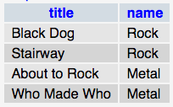
SELECT Track.title, Genre.name FROM Track JOIN Genre
ON Track.genre_id = Genre.genre_id

Slide 43
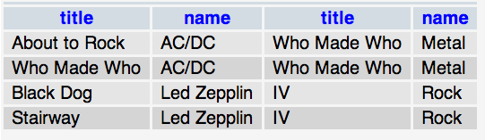
It Can Get Complex...
SELECT Track.title, Artist.name, Album.title, Genre.name FROM Track JOIN Genre JOIN Album JOIN Artist ON Track.genre_id = Genre.genre_id AND Track.album_id = Album.album_id AND Album.artist_id = Artist.artist_id
What we want to see
The tables that hold the data
How the tables are linked

Slide 45
ON DELETE CASCADE
Child
We are telling MySQL to "clean up" broken references
Parent
DELETE FROM Genre WHERE name = 'Metal'

Slide 46
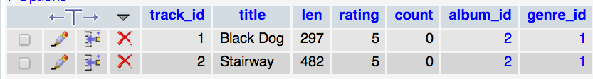
ON DELETE CASCADE
DELETE FROM Genre WHERE name = 'Metal'

Slide 47
ON DELETE Choices
Default / RESTRICT – Don’t allow changes that break the constraint
CASCADE – Adjust child rows by removing or updating to maintain consistency
SET NULL – Set the foreign key columns in the child rows to null
http://stackoverflow.com/questions/1027656/what-is-mysqls-default-on-delete-behavior

Slide 48
Many-to-Many Relationships

Slide 49
www.tsugi.org

Slide 50
belongs-to
Review:
One to Many
Track
Album
Title
One
Many
Rating
Len
Track
Count
id
Table
Primary key
Logical key
Foreign key
title
Album
One
rating
id
len
title
Many
count
album_id
https://en.wikipedia.org/wiki/One-to-many_(data_model)

Slide 51
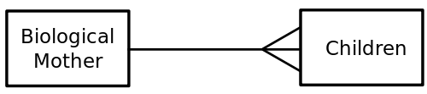
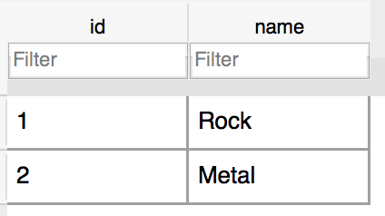
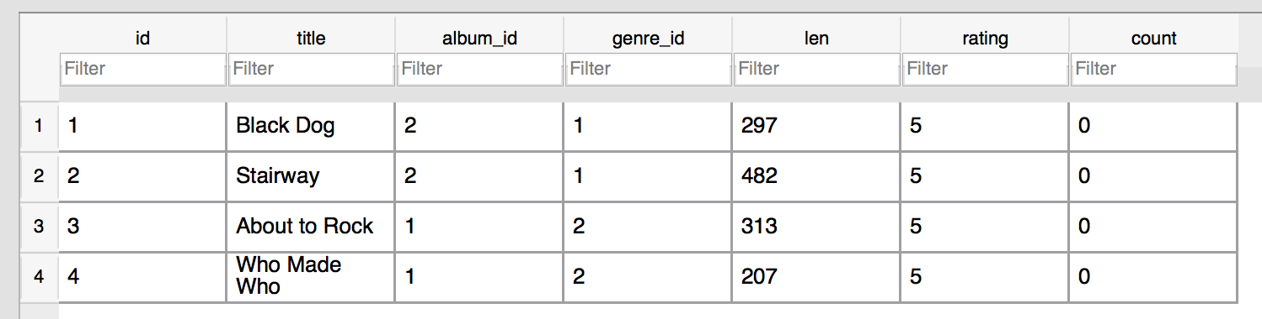
One
One
Many
Many
https://en.wikipedia.org/wiki/One-to-many_(data_model)

Slide 52

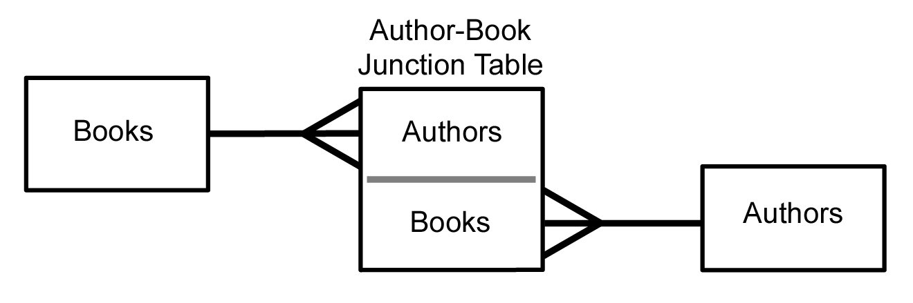
Many to Many
Sometimes we need to model a relationship that is many to many.
We need to add a “connection” table with two foreign keys.
There is usually no separate primary key.

Slide 53
member-of
User
Course
title
Many
Many
email
name
User
Course
Member
user_id
course_id
Many
user_id
email
title
Many
One
One
course_id
name
role
https://en.wikipedia.org/wiki/Many-to-many_(data_model)

Slide 54
Start with a Fresh Database
CREATE TABLE User (
user_id INTEGER NOT NULL AUTO_INCREMENT PRIMARY KEY,
email VARCHAR(128) UNIQUE,
name VARCHAR(128)
) ENGINE=InnoDB CHARACTER SET=utf8;
CREATE TABLE Course (
course_id INTEGER NOT NULL AUTO_INCREMENT PRIMARY KEY,
title VARCHAR(128) UNIQUE
) ENGINE=InnoDB CHARACTER SET=utf8;

Slide 55
Member
User
Course
Many
One
One
user_id
user_id
course_id
Many
course_id
email
title
role
name
CREATE TABLE Member (
user_id INTEGER,
course_id INTEGER,
role INTEGER,
CONSTRAINT FOREIGN KEY (user_id) REFERENCES User (user_id)
ON DELETE CASCADE ON UPDATE CASCADE,
CONSTRAINT FOREIGN KEY (course_id) REFERENCES Course (course_id)
ON DELETE CASCADE ON UPDATE CASCADE,
PRIMARY KEY (user_id, course_id)
) ENGINE=InnoDB CHARACTER SET=utf8;

Slide 56
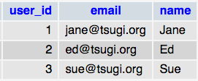
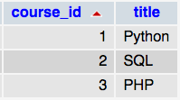
Insert Users and Courses
INSERT INTO User (name, email) VALUES ('Jane', 'jane@tsugi.org');
INSERT INTO User (name, email) VALUES ('Ed', 'ed@tsugi.org');
INSERT INTO User (name, email) VALUES ('Sue', 'sue@tsugi.org');
INSERT INTO Course (title) VALUES ('Python');
INSERT INTO Course (title) VALUES ('SQL');
INSERT INTO Course (title) VALUES ('PHP');

Slide 57
Insert Memberships
INSERT INTO Member (user_id, course_id, role) VALUES (1, 1, 1);
INSERT INTO Member (user_id, course_id, role) VALUES (2, 1, 0);
INSERT INTO Member (user_id, course_id, role) VALUES (3, 1, 0);
INSERT INTO Member (user_id, course_id, role) VALUES (1, 2, 0);
INSERT INTO Member (user_id, course_id, role) VALUES (2, 2, 1);
INSERT INTO Member (user_id, course_id, role) VALUES (2, 3, 1);
INSERT INTO Member (user_id, course_id, role) VALUES (3, 3, 0);

Slide 58
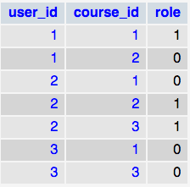

Slide 59
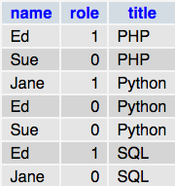
SELECT User.name, Member.role, Course.title
FROM User JOIN Member JOIN Course
ON Member.user_id = User.user_id AND
Member.course_id = Course.course_id
ORDER BY Course.title, Member.role DESC, User.name

Slide 60
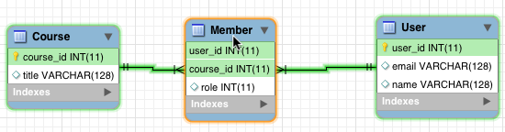
https://www.mysql.com/products/workbench/

Slide 61
www.tsugi.org

Slide 62
Complexity Enables Speed
Complexity makes speed possible and allows you to get very fast results as the data size grows.
By normalizing the data and linking it with integer keys, the overall amount of data which the relational database must scan is far lower than if the data were simply flattened out.
It might seem like a tradeoff - spend some time designing your database so it continues to be fast when your application is a success.

Slide 63
Summary
Relational databases allow us to scale to very large amounts of data.
The key is to have one copy of any data element and use relations and joins to link the data to multiple places.
This greatly reduces the amount of data that must be scanned when doing complex operations across large amounts of data.
Database and SQL design is a bit of an art form.

Slide 64

Acknowledgements / Contributions
These slides are Copyright 2010- Charles R. Severance (www.dr-chuck.com) as part of www.wa4e.com and made available under a Creative Commons Attribution 4.0 License. Please maintain this last slide in all copies of the document to comply with the attribution requirements of the license. If you make a change, feel free to add your name and organization to the list of contributors on this page as you republish the materials.
Initial Development: Charles Severance, University of Michigan School of Information
Insert new Contributors and Translators here including names and dates
Continue new Contributors and Translators here

